Slide 1

Back On Track
This specification document presents the "Back On Track" project, an interactive GIS application developed to assist businesses affected by the "Iron Swords" war. The project aims to enable the public to locate impacted businesses and support their economic recovery.
The project is submitted by Tom Eliasi, Ofir Suissa, and Nave Manu as part of the course "Application Development in the GIS Field."
Notes:
• הפרויקט "Back On Track" הוא אפליקציית GIS אינטראקטיבית שפותחה כדי לסייע לעסקים שנפגעו במלחמת "חרבות ברזל". • המטרה היא לאפשר לציבור לאתר בקלות את העסקים הללו ולתמוך בהתאוששותם הכלכלית. • האפליקציה מציגה עיצוב מודרני ומקצועי עם ממשק מפת המציג את מיקומי העסקים הנפגעים. • הפרויקט מוצג על ידי צוות של שלושה סטודנטים במסגרת הקורס "פיתוח אפליקציות בתחום ה-GIS". • המטרה היא לעזור לעסקים אלה להתאושש ולחזור "על המסלול" לאחר האירועים המאתגרים.

Slide 2

General Background
and Project Objective
The Challenge
During the "Iron Swords" war and the evacuation of residents from the northern and southern regions, many businesses faced significant economic challenges and struggled to maintain contact with their customers.
The Need
The impact of the war highlighted the necessity of providing accessible information about these businesses and offering supportive tools to aid in their recovery.
The Objective
The development of an interactive GIS application called "Back On Track", enabling the public to locate businesses affected by the war and supporting their economic recovery.

Slide 3
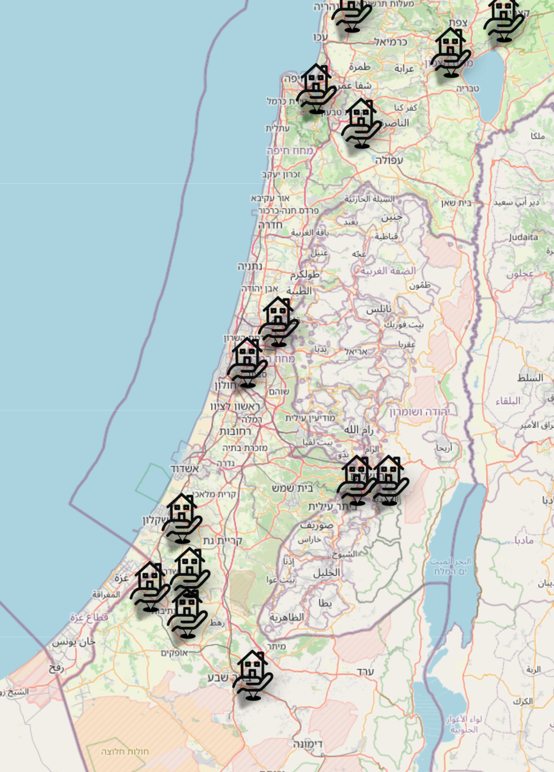
System Overview – Application Nature
1
Application Type
The "Back On Track" application will be developed as a responsive web application using HTML, CSS, and JavaScript on the client side. The server-side logic will utilize Node.js to handle requests and efficiently manage data flow.
2
Geographic Component
The application will utilize the Leaflet.js library for rendering interactive maps and will use OpenStreetMap (OSM) as the mapping service. Geolocation APIs will enable the application to detect the user's location and dynamically display relevant businesses.
Database
3
The project will utilize a GeoJSON file to manage spatial data and business attributes. The data will be enriched and regularly updated using web scraping tools such as Puppeteer, combined with the Geopy library for geocoding. For analyzing external datasets, the PapaParse library will be used to process CSV inputs when needed.

Slide 4

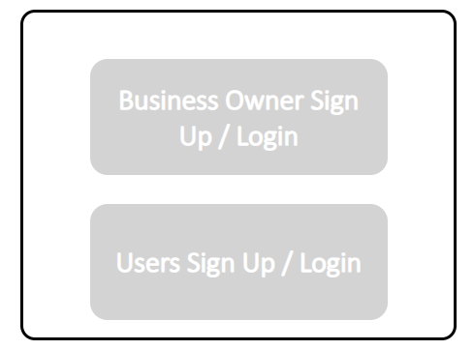



System Users
Not implemented due to time constraints, as previously stated in the specification document.
System Administrator
Business Owners
General Users
System administrators will have access to the code only, allowing them to make changes and updates at the infrastructure level of the application.
Business owners who have been affected can register and add their business details to the application, update their information as needed, and highlight special offers or services.
The general public can access the application without the need for registration or login, allowing them to search for businesses and use the available filters. However, if a user wishes to rate a business or leave a review, they will be required to register.

Slide 5
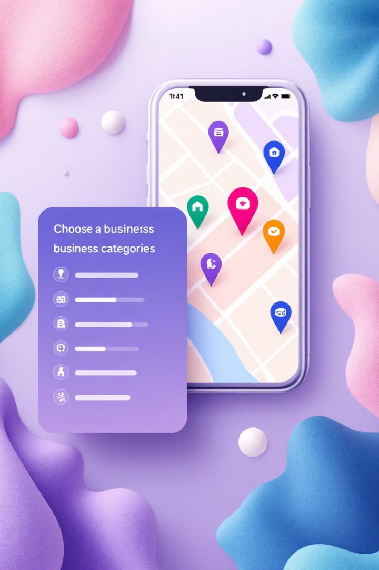
Application Features – Business Search
Business Layers
1
The application will display business layers that can be filtered by various categories. The map will dynamically update based on zoom and movement, showing relevant details according to the selected filters.
Business Card
2
The layers will include the business name, type (e.g., restaurant, professional service, retail store, etc.), operating hours, and additional attributes such as child-friendliness, special offers, or delivery services.
3
Filter Menu
The filter menu will include options such as location, business type, opening days, child-friendly businesses, active promotions, and delivery or in-store purchase options.

Slide 6
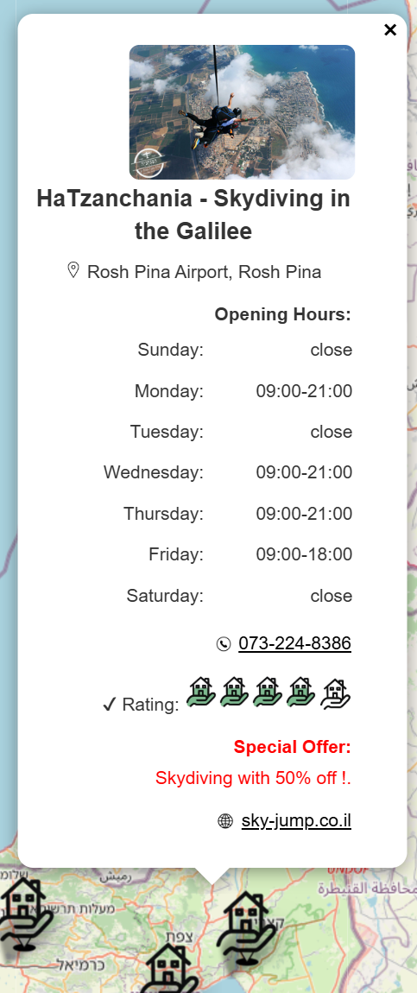
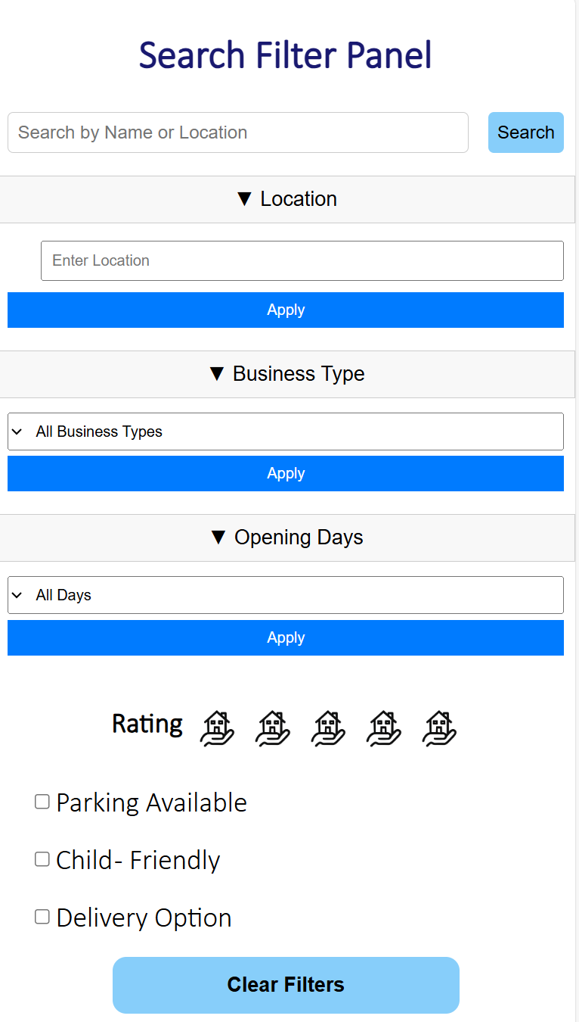
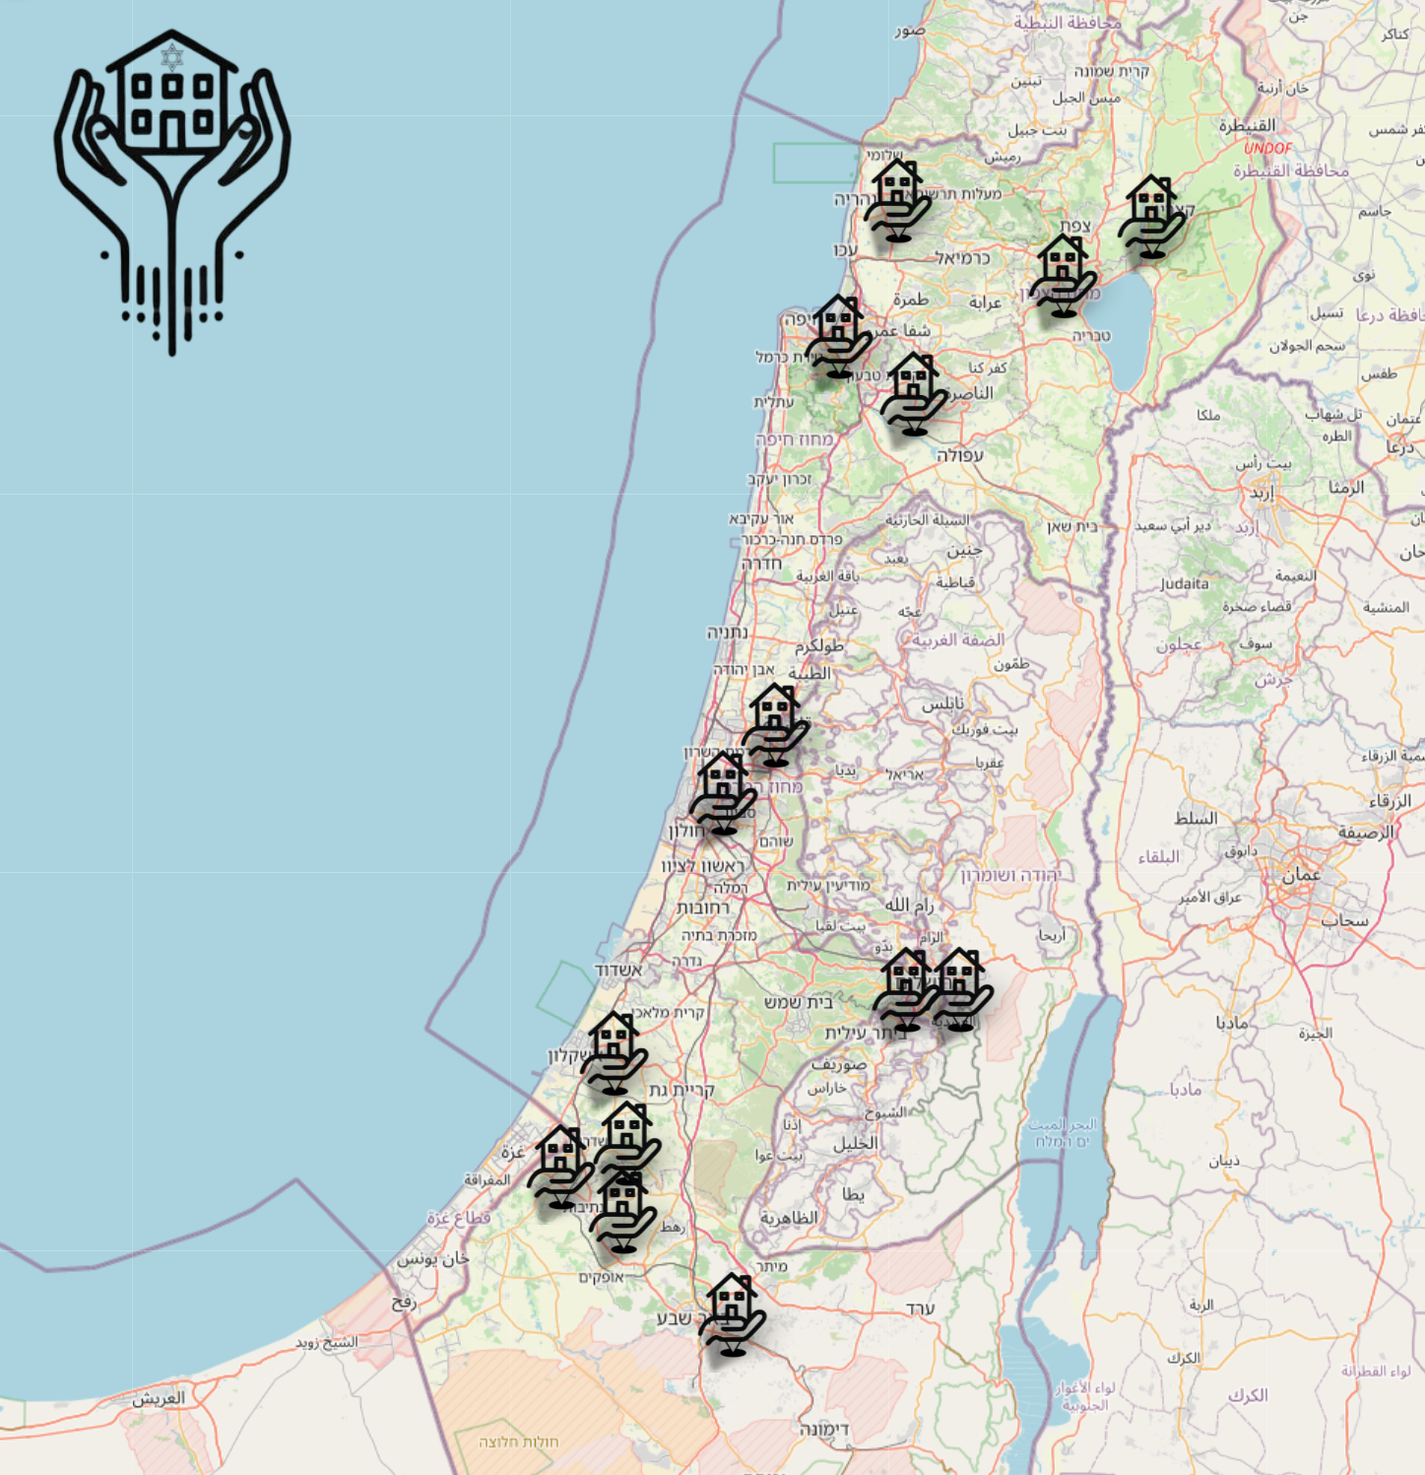
System
Screens
Business Details Window
Filters Panel
Main Screen
Clicking on a specific business icon on the map opens a popup window with detailed information, including:
- Business name, address, and contact details
- Business type and operating hours
- Child-friendliness, delivery options, and other specific criteria
- Link to the business website or contact options for further actions
- Special offers and promotions
Located on the side, the filters panel allows users to refine the displayed businesses based on: location (region or specific city), business type, operating hours, child-friendly businesses, additional criteria such as delivery availability or parking facilities, and rating.
The main screen of the application serves as the central interface, displaying all features without requiring user registration. Business locations are dynamically shown on the map based on their geographic data and the user's selected filter options.

Slide 7
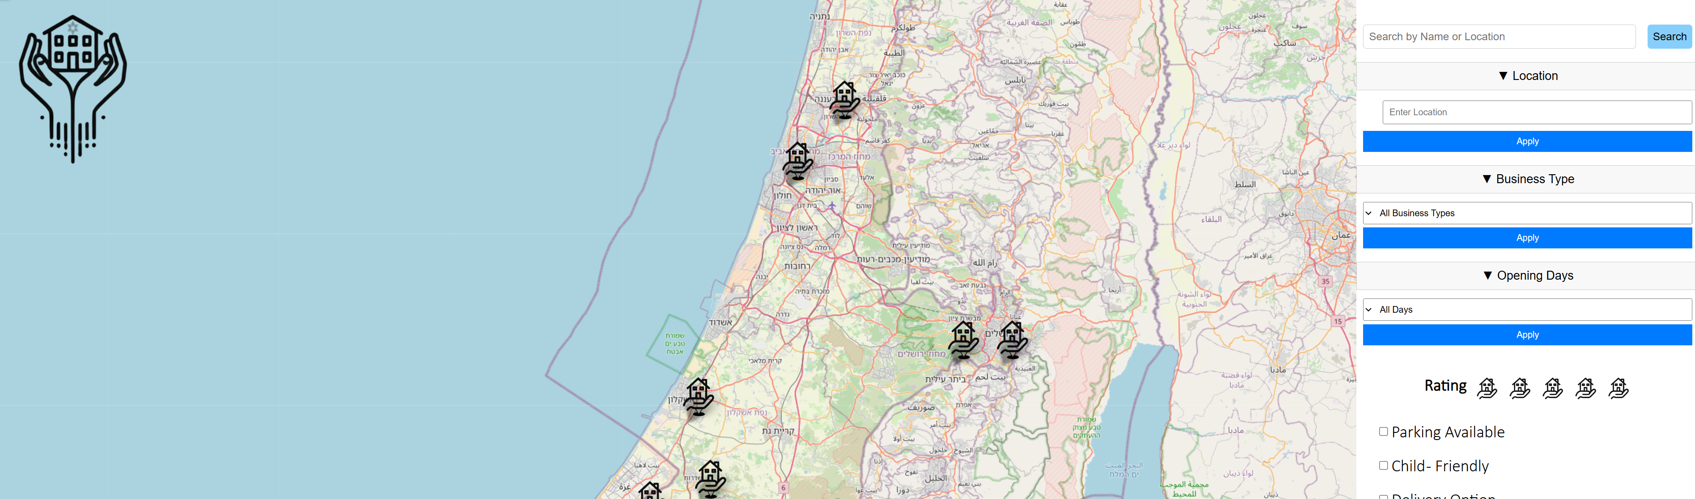
Dynamic Map Integration
Reset Filters
A reset filters button clears all selected filters and displays the full list of businesses across all regions, allowing users to restart their search easily.
Ratings & Reviews
Users who want to rate a business can click the "Rate" button, which prompts them to sign up or log in. After registration, users can submit ratings and reviews, which influence how businesses are displayed on the map.
Map Interaction
Hovering over or zooming into the map reveals additional details. The map dynamically updates based on user movement and selected filters.
Business Display
All businesses are shown on an interactive map powered by OpenStreetMap and Leaflet.js. Business locations are represented by logo icons, making them easily identifiable.
Not implemented due to time
constraints,
as previously stated in the
specification document.

